Slide 1
Apache kylin
Kevin ezra patar hasudungan
68770

Slide 2
AGENDA
Overview
Prerequisite
Kylin
Query

Slide 3
Overview

Slide 4

Apache kylin
Apache Kylin is a Open source OLAP engine that is used to process Big Data.

Slide 5
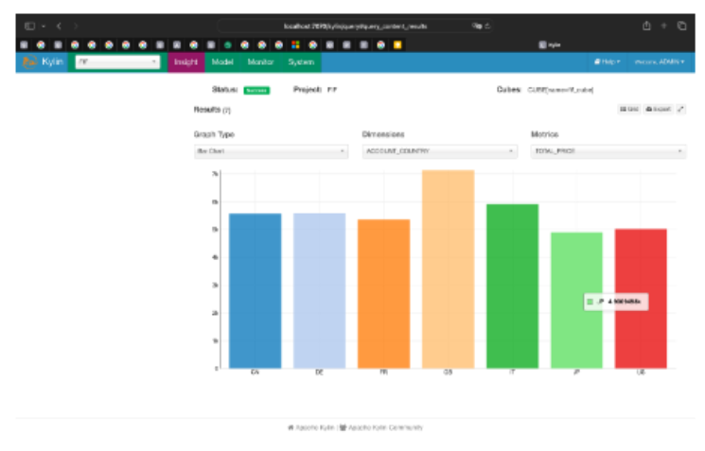
Target
In this exercise, we will try to practice using Apache Kylin to Stream data into cubes. Below is the goal of this practice

Slide 6
prerequisite

Slide 7
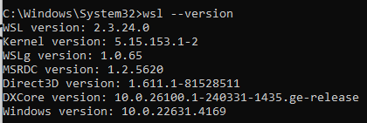
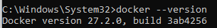
Prerequisite
Docker Desktop
16 GBs of RAM (preferabbly)

Slide 8
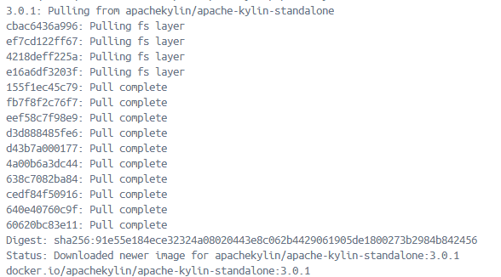
Pull image from docker repository
docker pull apachekylin/apache-kylin-standalone:3.0.1
The output should be like this

Slide 9
Create container from image
docker run -d -m 8G -p 7070:7070 -p 8088:8088 -p 50070:50070 -p 8032:8032 -p 8042:8042 -p 16010:16010 apachekylin/apache-kylin-standalone:3.0.1
The output should be like this
Explanation: docker run is used to run the image. Here are the explanations of the command arguments
-d is used to start in detached mode, that runs in the background
-p is used to exposed the needed ports
The last args is choosing the image
You should see the container in the docker desktop, or you could run docker ps command to see the status of the container. After that you start the existing container, by pressing the start button on container or run docker start <docker-id>

Slide 10
Apache Kylin

Slide 11
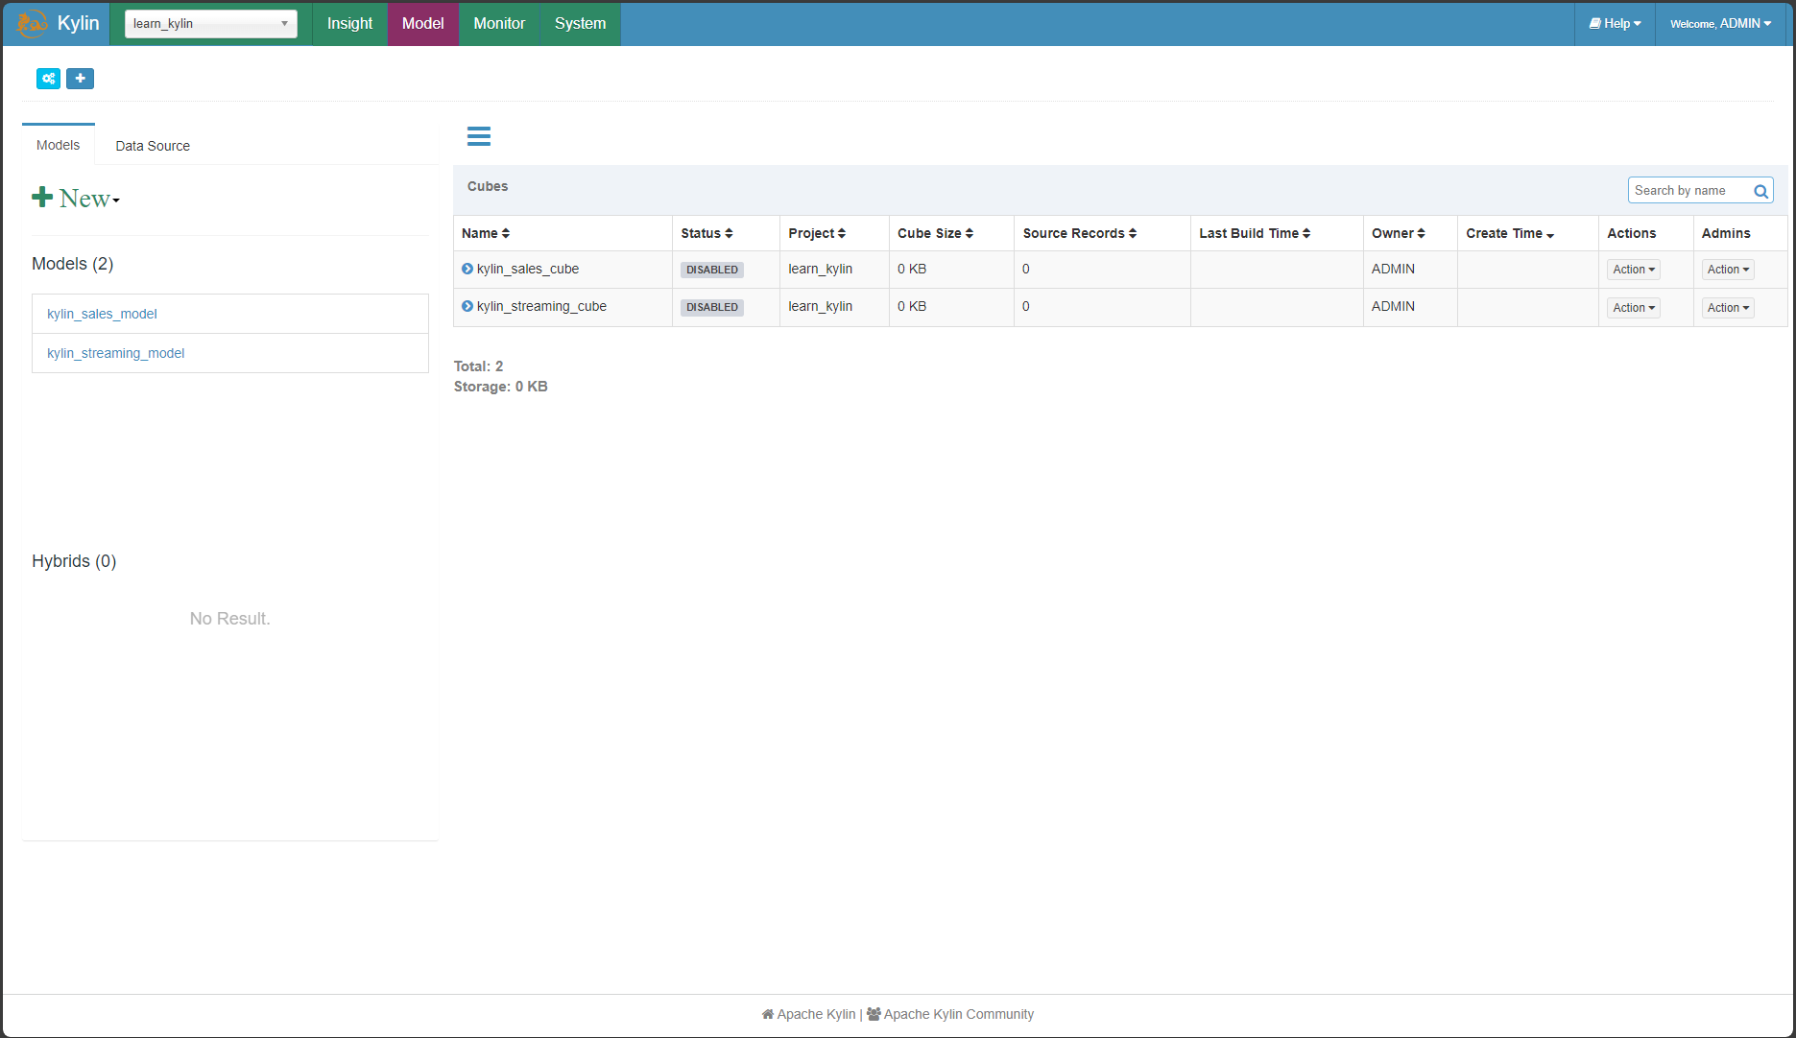
Kylin preview
Go to http://localhost:7070/kylin

Slide 12
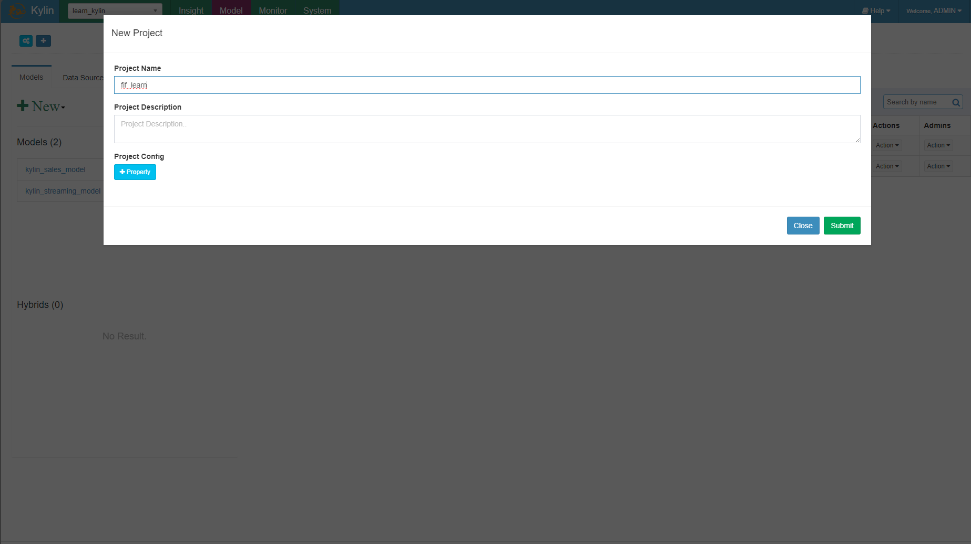
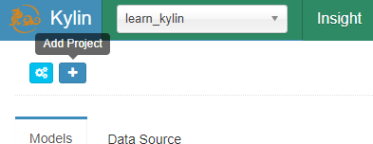
Create new project on kylin

Slide 13
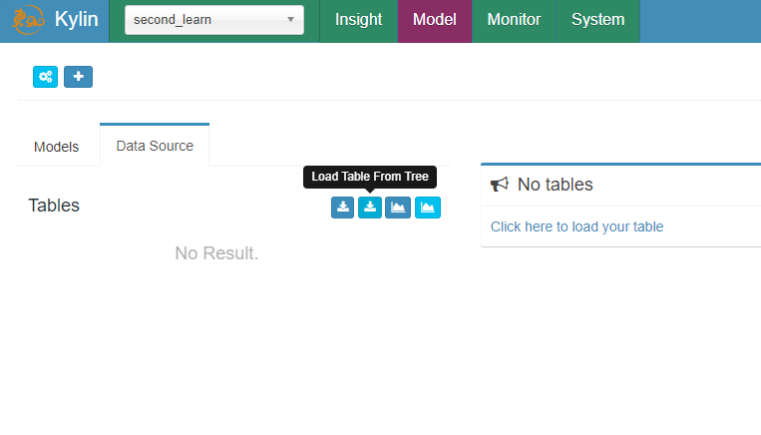
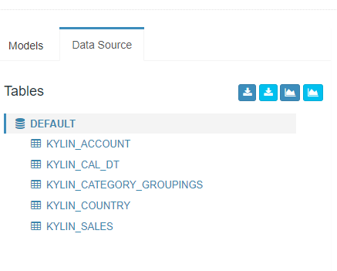
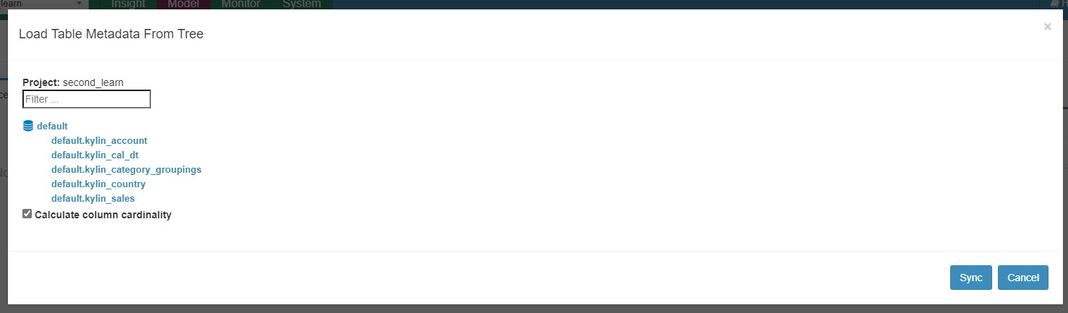
Create new data source
Go to Data Source
Click Load Table From Tree
Checks all data in default
Click Sync
After all of the steps above, all the tables should show in the Data Source

Slide 14
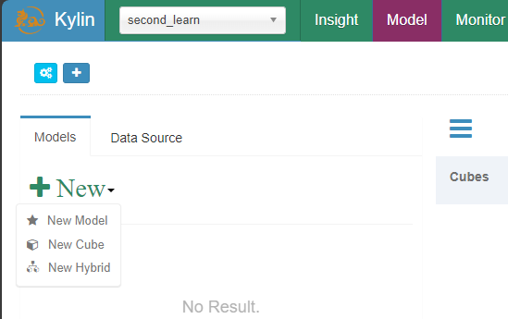
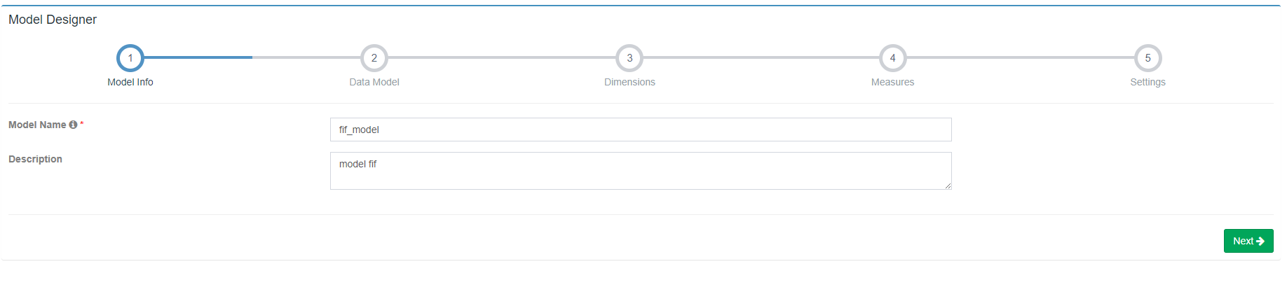
Create new model

Slide 15
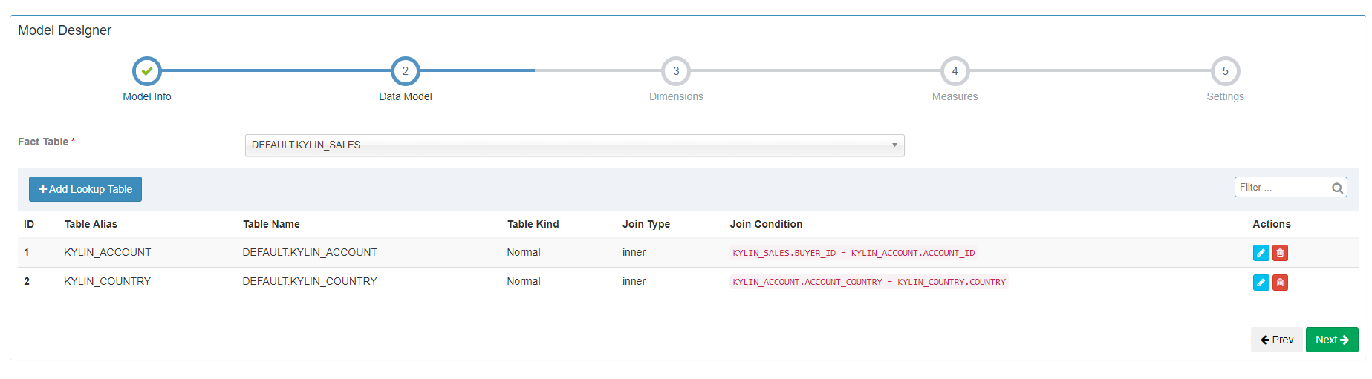
Model configuration
On the Data Model section, choose KYLIN_SALES as the Fact table, and then add Lookup Table. Follow the existing Table Alias above

Slide 16
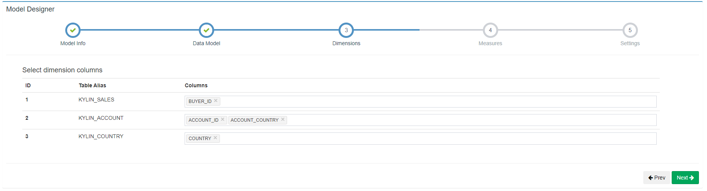
Model configuration
On the Dimensions, choose the Dimension Columns on every table.

Slide 17
Model configuration
On the Settings section, you could configure filter for the selected data. You could also partition the table based on date.

Slide 18
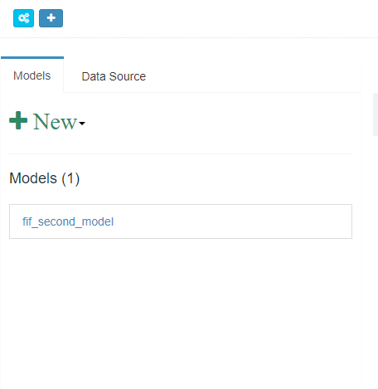
Model configuration
After you save the model, the model should appear on the left of the Kylin GUI.

Slide 19
Create new cube
After creating the Model, you proceed by creating new Cube. On the left, you could press the New dropdown, and then press New Cube. A page shown below should appear.

Slide 20
Cube configuration
On the Cube Info, use the model that you’ve created previously, and then give it a name.

Slide 21
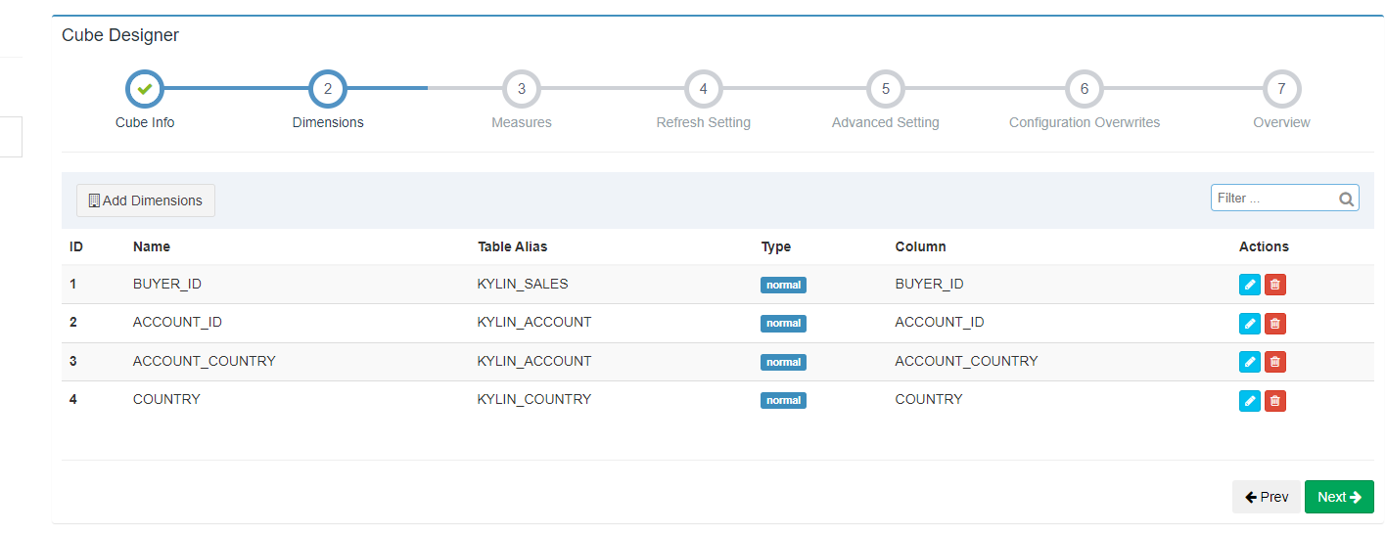
Cube configuration
On the Dimension section, choose Add Dimensions and checks all the tables. On the Lookup Table, change the Radio button from Derived to Normal.

Slide 22
Cube configuration
On the Measure Section, add new Measure. The Expression is the Aggregate function, Param type is the parameters that we’re going to use (column or constants), and the param value is the value that we’re going to use based on the param type. Follow the following instruction, then click Ok.

Slide 23
Cube configuration
Refresh Setting section is used to configure the Partition, like merge it, retention, and the start date. In this practice, we don’t need to configure this.

Slide 24
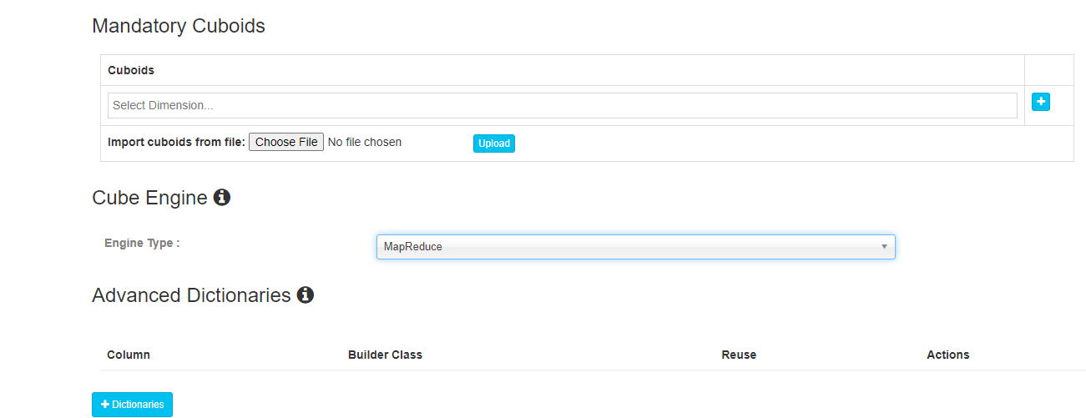
Cube configuration
On the Advance Setting, you could configure the Cube, like adding aggregation groups, rowkeys, etc. But in this practice we don’t need to configure this. In this section, you just need to scroll down to Cube Engine, and choose MapReduce as the Engine.

Slide 25
Cube configuration
On the Configuration Overwrites, we don’t need to configure anything. We just use the default setting from Kylin. After that we just need to proceed to Next, and then Save the cube.

Slide 26
Cube configuration
If you’re successfull, the created Cube should appear on the Cubes table on the dashboard.

Slide 27
Build cube
After successfully creating the Cube, go to the Action on the desired cube, and then click build.

Slide 28
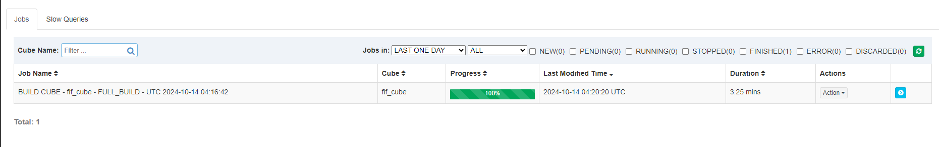
Build cube
You could go to the Monitor tab to see if the Cube is being built. Wait until it’s finished like the picture below. It could take a while.

Slide 29
Query on kylin

Slide 30
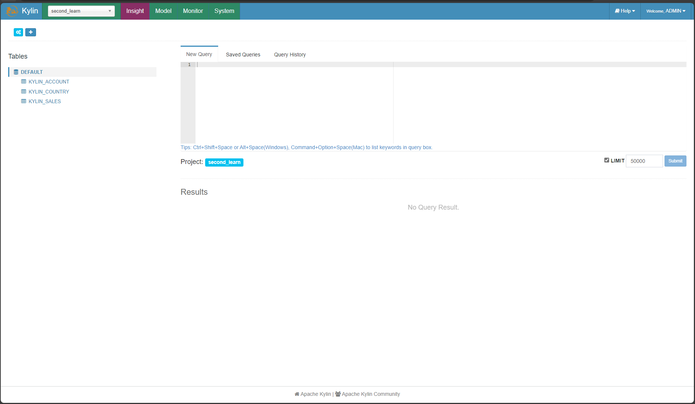
Kylin Insight
If your cube is finished building, on the Insight tab you should see the tables created based on the configuration on the model & cube.

Slide 31
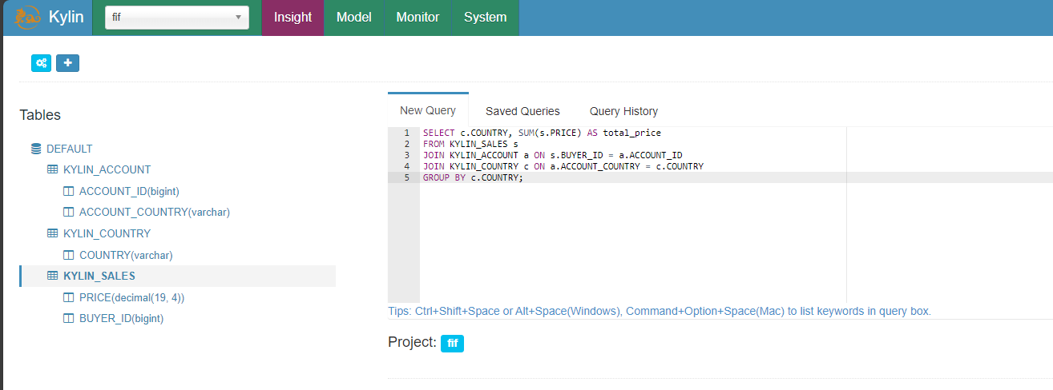
Kylin Insight
To produce the desired output like on the start of this practice, write query below
SELECT c.COUNTRY, SUM(s.PRICE) AS total_price
FROM KYLIN_SALES s
JOIN KYLIN_ACCOUNT a ON s.BUYER_ID = a.ACCOUNT_ID
JOIN KYLIN_COUNTRY c ON a.ACCOUNT_COUNTRY = c.COUNTRY
GROUP BY c.COUNTRY;

Slide 32
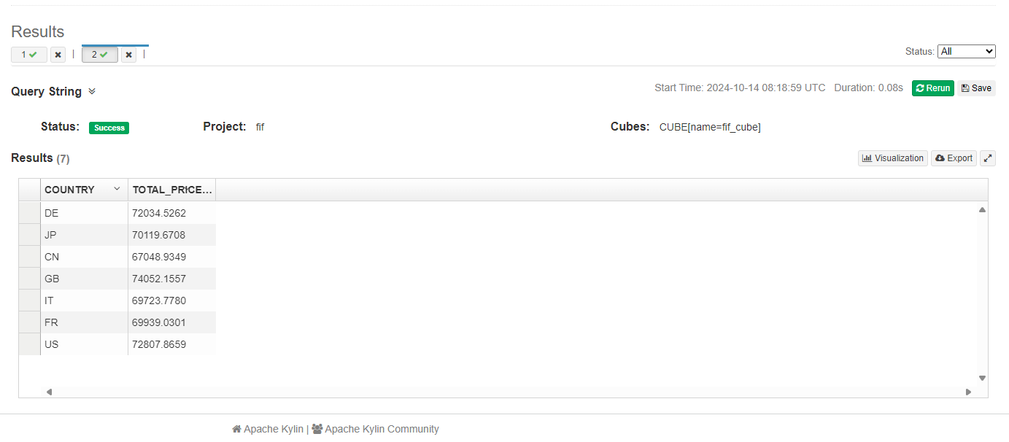
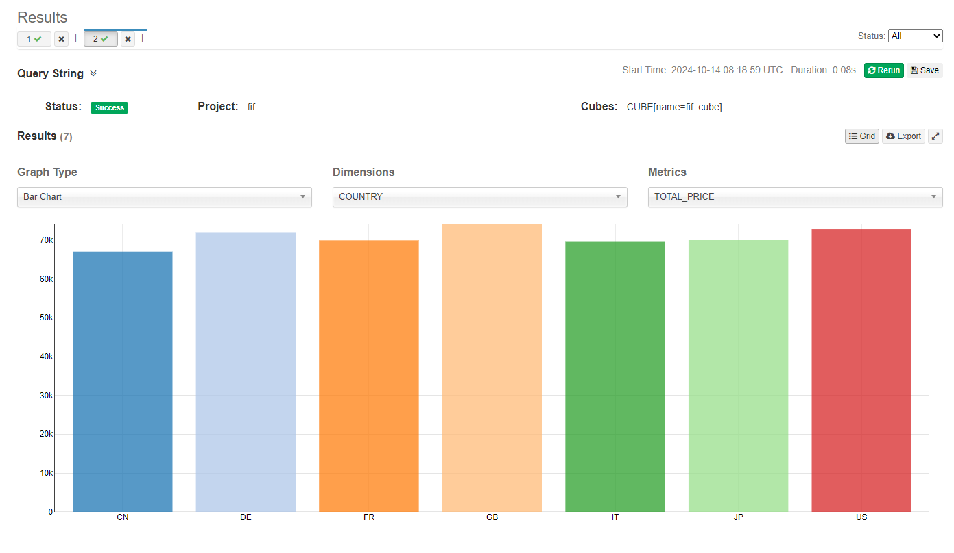
result
These are the results. If you want to see the result using charts, click Visualization.

Slide 33
THANK YOU
Kevin Ezra Patar Hasudungan
kevin.ephasudungan@fifgroup.astra.co.id (Work)
tkevinrocket@gmail.com (Personal)
+62-811-8472-355

